Slide 1
Build Private/Hybrid Cloud using Open-Source tools
Shakti Mishra

Slide 2
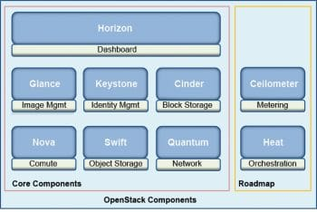
OpenStack (www.openstack.org)
OpenStack was founded in 2010 by two small groups of engineers from Rackspace and NASA
combination of open source tools that can be used to create private and public clouds
OpenStack source code is open, it can be modified and changed as per the users’ needs

Slide 3
OpenStack Ecosystem
Ecosystem: OpenStack comprises six core services and 13 optional services
Keystone: This is the authorisation and authentication component of OpenStack. It handles the creation of the environment and is the first component installed.
Nova: This manages the computing resources of the OpenStack cloud. It takes care of instance creation and sizing as well as location management.
Neutron: This is responsible for creating virtual networks within the OpenStack cloud. This module creates virtual networks, routers, sub-nets, firewalls, load balancers, etc.
Glance: This manages and maintains server images. It facilitates the uploading and storing of OpenStack images.
Cinder: This provides block storage, as a service, to the OpenStack cloud. It virtualises pools of block storage devices and provides end users with a self-service API to request and consume resources without requiring any storage knowledge.
Swift: This comprises storage systems for objects and files. It makes scaling easy, as developers don’t have to worry about the system’s capacity. It allows the system to handle the data backup in case of any sort of machine or network failure.
Horizon: This is the dashboard of OpenStack. It provides a GUI interface to users to access all components of OpenStack via the API and enables administrators to use the OpenStack cloud.
Ceilometer: This provides telemetry services, including billing services to individual users of the cloud.
Heat: This is the orchestration component of OpenStack, allowing developers to define and store the requirements of a cloud application in a file.
OpenStack can be deployed using the following models.
OpenStack-based public cloud: In this case, the vendor provides a public cloud computing system based on the OpenStack project.
On-premise distribution: Here, the clients download and install the distribution within their customised network.
Hosted OpenStack private cloud: In this case, the vendor hosts the OpenStack based private cloud, including the hardware and software.
OpenStack-as-a-Service: Here, the vendor hosts OpenStack management Software as a Service.
Appliance based OpenStack: This covers compatible appliances that can be added into the network provided by Nebula.

Slide 4
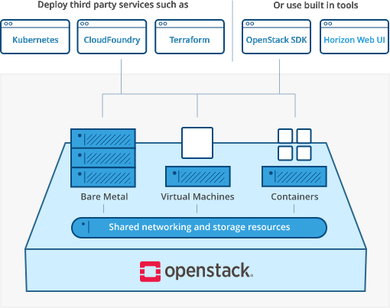
OpenStack Landscape

Slide 5
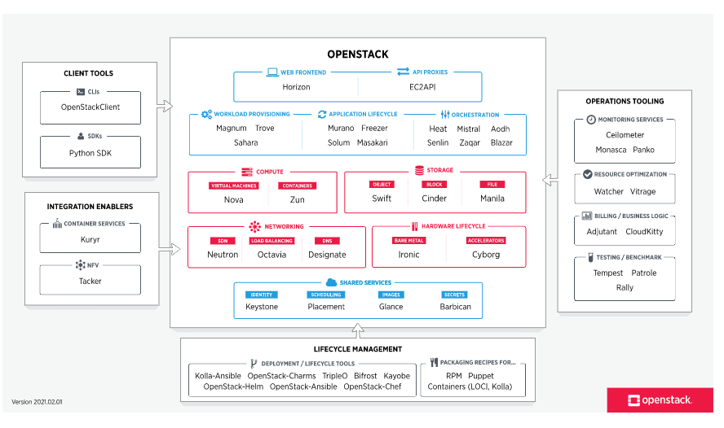

Slide 6
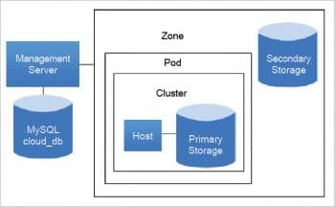
Apache CloudStack (https://cloudstack.apache.org)
Open source software especially designed to deploy and manage large networks of virtual machines to create highly scalable, available and secured IaaS based computing platforms
Provides a cloud orchestration layer that automates the creation, provisioning and configuration of IaaS components
Provides powerful features that enable a secure multi-tenant cloud computing environment.

Slide 7
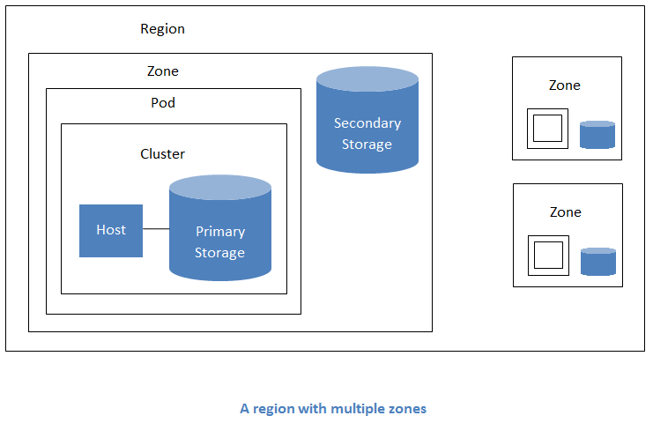

Slide 8
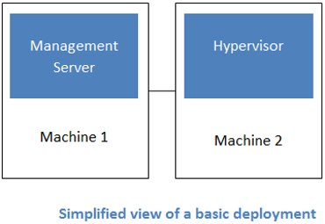
Architecture
Apache CloudStack deployment involves two parts –
the management server and
the resources to be managed.
Two machines are required to deploy Apache CloudStack—the CloudStack management server and the cloud infrastructure server.

Slide 9
Apache CloudStack Deployment
Management Server
Provides the web interface for both the adminstrator and end user.
Provides the API interfaces for both the CloudStack API as well as the EC2 interface.
Manages the assignment of guest VMs to a specific compute resource
Manages the assignment of public and private IP addresses.
Allocates storage during the VM instantiation process.
Manages snapshots, disk images (templates), and ISO images.
Provides a single point of configuration for your cloud.

Slide 10
Cloud Infrastructure
Regions: A collection of one or more geographically proximate zones managed by one or more management servers.
Zones: Typically, a zone is equivalent to a single datacenter. A zone consists of one or more pods and secondary storage.
Pods: A pod is usually a rack, or row of racks that includes a layer-2 switch and one or more clusters.
Clusters: A cluster consists of one or more homogenous hosts and primary storage.
Host: A single compute node within a cluster; often a hypervisor.
Primary Storage: A storage resource typically provided to a single cluster for the actual running of instance disk images. (Zone-wide primary storage is an option, though not typically used.)
Secondary Storage: A zone-wide resource which stores disk templates, ISO images, and snapshots.

Slide 11
Eucalyptus cloud platform
Eucalyptus stands for Elastic Utility Computing Architecture for Linking Your Programs To Useful Systems.
It is designed based on extensible and modular architecture for Web services.
It also implements the industry standard Amazon Web Services (AWS) API.

Slide 12
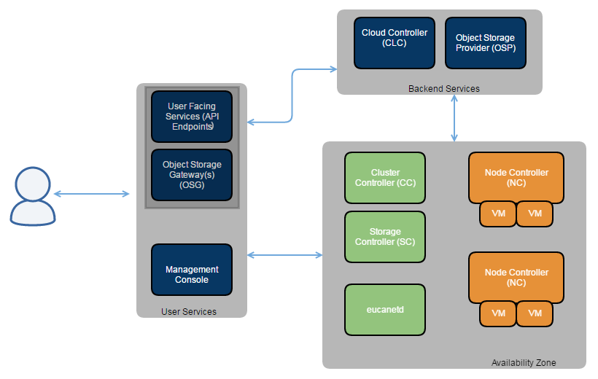

Slide 13
Components
Cloud controller: This is the main controller that manages the entire platform and provides a Web and EC2 compatible interface. It performs scheduling, resource allocation and accounting.
Walrus: Works like AWS S3 (Simple Storage Service). It offers persistent storage to all virtual machines in the cloud and can be used as a simple HTTP put/get Solution as a Service.
Cluster controller: Manages VM execution and SLAs. Communicates with the storage controller and node controller, and is the front end for the cluster.
Storage controller: Communicates with the cluster controller and node controller, managing all block volumes and snapshots to the instances within the specific cluster.
VMware broker: Provides an AWS-compatible interface for VMware environments and physically runs on the cluster controller.
Node controller: Hosts all virtual machine instances and manages the virtual network endpoints.

Slide 14
Architecture
Images: Software modules, configuration, applications or software deployed in the Eucalyptus cloud.
Instances: Images when used are called instances. The controller decides how to allocate memory and provide all resources.
Networking: This comprises three modes – the managed mode for the local network of instances including security groups and IP addresses, the system mode for MAC address allocation and attaching the instance network interface to the physical network via NC’s bridge, and the static mode for IP address allocation to instances.
Access control: Every use of Eucalyptus is assigned an identity and these identities are grouped together for access control.
Elastic block storage: This provides block-level storage volumes that are attached to an instance.
Auto scaling and load balancing: This creates and destroys instances automatically based on requirements.

Slide 15
Reference
https://www.openstack.org/software/project-navigator/openstack-components/#openstack-services
http://docs.cloudstack.apache.org/en/latest/
https://docs.eucalyptus.cloud/eucalyptus/5/install_guide/intro/euca_components/

